Slide 1

Athletic Field & Facility Allocation Policy
Notes:
Preface / Description

Slide 2
Athletic Field & Facility Allocation Policy
Introduction
Ensure fair and equitable access to our city’s athletic fields and facilities
Developed by staff following parks and recreation industry best practices
Vetted through Parks and Recreation Advisory Committee & approved by our City Council
Policy prioritizes need of our residents and community-based organizations
Notes:
Preface / Description

Slide 3

Athletic Field & Facility Allocation Policy
Background
Demand exceeds availability
Policy will ensure a fair and equitable allocation of field space and ensures that SFS residents are prioritized above other non-resident groups
Previously fields were distributed on a first-come, first-served basis
The Policy aims to prioritize Santa Fe Springs’ residents, where teams/organizations that meet a 60% SFS resident threshold receive priority usage of fields
Policy establishes different categories for the different types of teams, aimed at prioritizing resident usage
Notes:
Preface / Description

Slide 4

Athletic Field & Facility Allocation Policy
Priority Group Classifications
1. Activities or programs conducted and/or sponsored or co-sponsored by the City of Santa Fe Springs.
2. Recognized Groups (priority per agreement with the City):
  a. Metropolitan Little League
  b. Norwalk/Santa Fe Springs Saints Football & Cheer
3. Schools located within the City of Santa Fe Springs boundaries
4. Resident Youth Non-Profit Groups (60% residency)
5. Non-Profit Resident Adult Groups (60% residency)
6. Business Resident Groups (60% residency)
7. Youth Resident Groups (60% residency)
8. Adult Resident Groups (60% residency)
9. Youth Non-Resident, Non-Profit Groups
10. Youth Non-Resident Groups
11. Adult Non-Resident, Non-Profit Groups
12. Adult Non-Resident Groups
13. All Other Groups
EXAMPLE
Team A
Youth Travel Ball Team
60% SFS Residents
Priority Group #7
Team B
Youth Travel Ball Team
25% SFS Residents
Priority Group #10
Notes:
Photo / Video

Slide 5
Athletic Field & Facility Allocation Policy
Priority Group Classifications
1. Activities or programs conducted and/or sponsored or co-sponsored by the City of Santa Fe Springs.
2. Recognized Groups (priority per agreement with the City):
  a. Metropolitan Little League
  b. Norwalk/Santa Fe Springs Saints Football & Cheer
3. Schools located within the City of Santa Fe Springs boundaries
4. Resident Youth Non-Profit Groups (60% residency)
5. Non-Profit Resident Adult Groups (60% residency)
6. Business Resident Groups (60% residency)
7. Youth Resident Groups (60% residency)
8. Adult Resident Groups (60% residency)
9. Youth Non-Resident, Non-Profit Groups
10. Youth Non-Resident Groups
11. Adult Non-Resident, Non-Profit Groups
12. Adult Non-Resident Groups
13. All Other Groups
EXAMPLE
Team A
Youth Travel Ball Team
60% SFS Residents
Priority Group #7
Team B
Youth Travel Ball Team
80% SFS Residents
Priority Group #7
Notes:
Photo / Video

Slide 6
Athletic Field & Facility Allocation Policy
Allocation Formula
EXAMPLE
Team A
6 SFS residents
Team B
40 SFS residents
Allocation Formula
Sum of SFS Residents = % of Time Allocated
Team # of SFS Residents ÷ Sum of SFS Residents
6 + 40 = 46
6 ÷ 46 = 13%
40 ÷ 46 = 87%
Team A Usage Time: 6 / 46 = 13%
Team B Usage Time: 87%
EXAMPLE
Team A
Youth Travel Ball Team
60% SFS Residents
6 of 10
Priority Group #7
Team B
Youth Travel Ball Team
80% SFS Residents
40 of 50
Priority Group #7
Notes:
Photo / Video

Slide 7
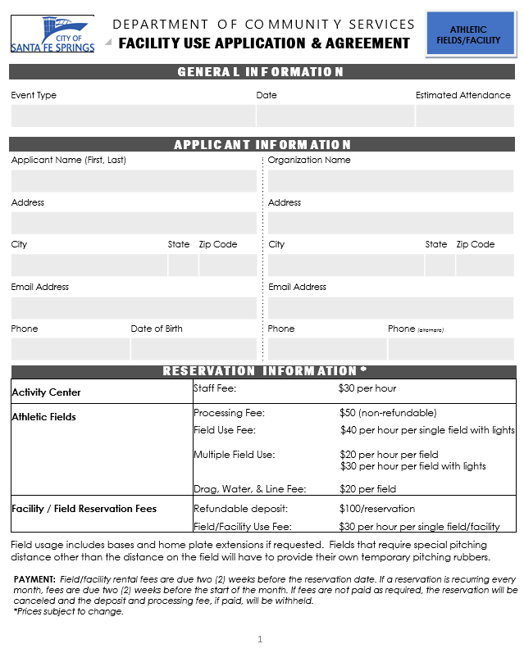
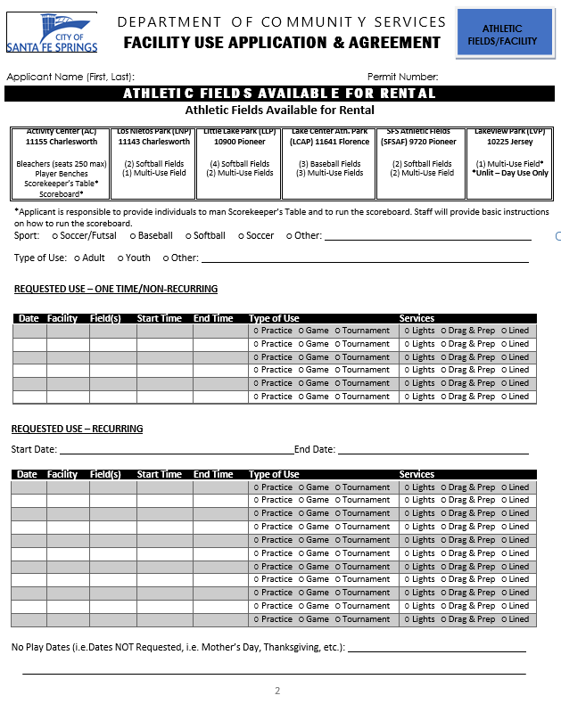
Application Process
Notes:
Preface / Description

Slide 8
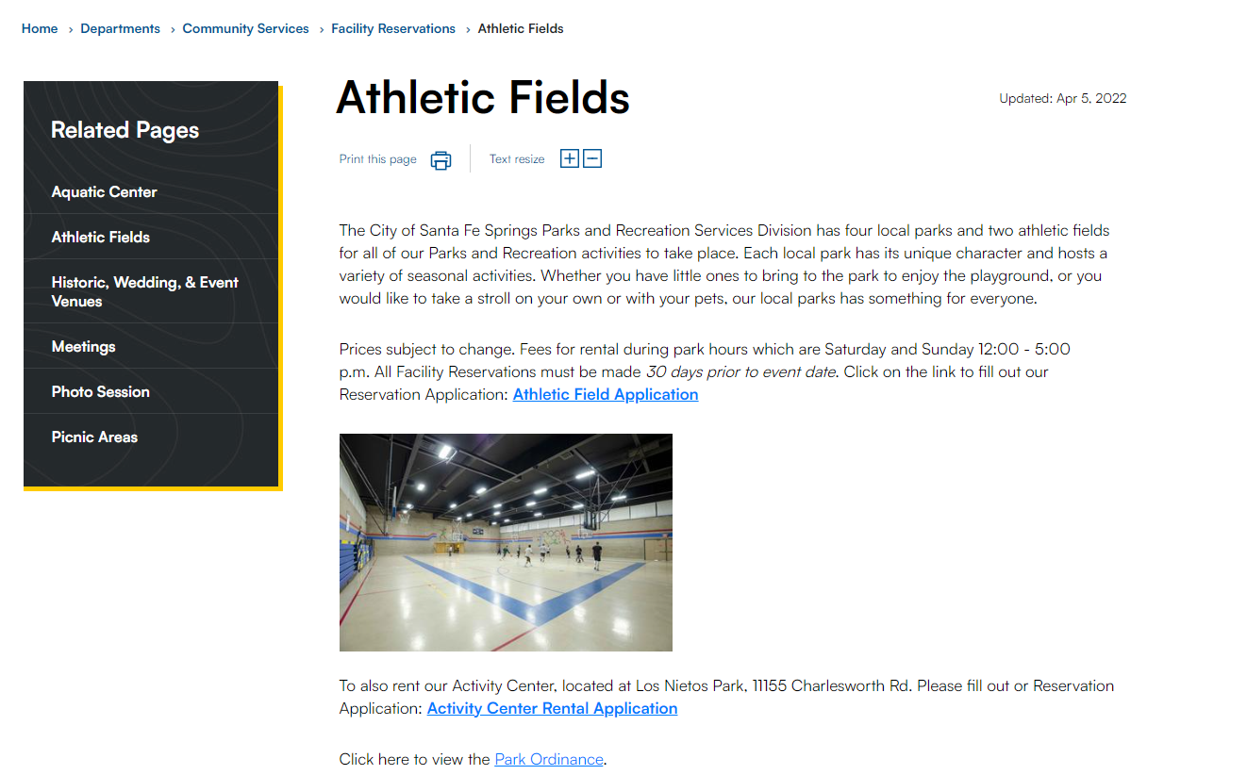
Athletic Field & Facility Allocation Policy
Application Process
https://www.santafesprings.org/departments/community_services/facility_reservations/athletic_fields.php
Notes:
Preface / Description

Slide 9
Athletic Field & Facility Allocation Policy
Application Process
Previous Process
Reservation Occurs: Jan-Jun 2024
Application Due: Jul 2023
Reservation Occurs: Jul-Dec 2024
Application Due: Jan 2024
Notes:
Preface / Description

Slide 10
Athletic Field & Facility Allocation Policy
Application Process
Implemented Policy
*Reservation Occurs: May, Jun, Jul
Application Due: Feb 1-15
**Reservation Occurs: Aug, Sep, Oct
Application Due: May 1-15
Reservation Occurs: Nov, Dec, Jan
Application Due: Aug 1-15
Reservation Occurs: Feb, Mar, Apr
Application Due: Nov 1
Current
Reservation Occurs: Jan-Jun 2024
Application Due: Jul 2023
Reservation Occurs: Jul-Dec 2024
Application Due: Jan 2024
Notes:
Preface / Description

Slide 11
Athletic Field & Facility Allocation Policy
Other Items Contained in the Policy
Definition of Terms
Requirement for submittal of team rosters
Insurance requirements
Payment Schedules
Inclement Weather/Field Closure Procedures
State Laws
Code Conduct
Waiver, Release, Hold Harmless & agreement Not to Sue
Photography/Video Release
Notes:
Preface / Description

Slide 12
QUESTIONS ?
Notes:
Preface / Description

